Slide 1
It’s your light that lights the world
Rumi

Slide 2
Discussion on:
Modern Advertising trends
in the world
And South Asia

Slide 3
Advertising
Communication : Between Seller / Service Provider and
Buyer / Subscriber
Type of Communication: Verbal, Non-verbal or a mix of both
Content : Which may attract the attention of the TG;
Also help stand away from the clutter
Media : Any which the TG is exposed to : FOCUS

Slide 4
Global Ad Spend figures ( Billion US $ )
 | 2016 | 2017 | 2018 | 2019 | 2020 | 2021
Asia Pacific | 176.42 | 187.49 | 200.81 | 211.57 | 224.31 | 237.77
Central and Eastern Europe | 13.46 | 14.52 | 15.24 | 16.09 | 16.93 | 17.77
Latin America | 36.41 | 38.77 | 40.88 | 43.39 | 46.16 | 49.17
Middle East and Africa | 17.47 | 18.09 | 20.22 | 21.57 | 22.87 | 24.3
North America | 188.68 | 193.66 | 202.37 | 210.9 | 219.14 | 227.57
Western Europe | 92.06 | 94.85 | 97.46 | 100.32 | 103.16 | 105.92
Worldwide | 524.5 | 547.37 | 576.98 | 603.83 | 632.57 | 662.5

Slide 5
Trends
Current :
World – TV dominates but Digital fast taking over the traditional and will take over by 2021
USA – Digital has already taken over TV ad spend in 2018
China – TV leads but Digital to overtake by 2021
India - Traditional media still dominates but digital to take over by 2021
Nepal : No exact figs but traditional media led by Print media dominates. Broadcasting media retains its importance BUT this market will also follow the same course as the world, maybe a little later but sure.
Although it seems a war between screens. Print and Outdoors would still retain their position as important media in south Asia

Slide 6
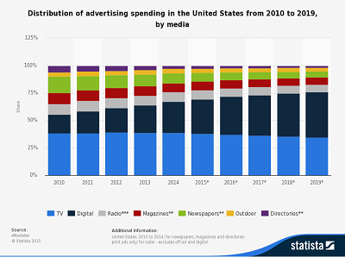
Digital takes over TV in USA in 2018 :

Slide 7
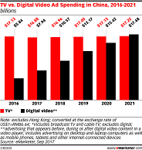
Digital fast moving ahead to take over TV in China :

Slide 8
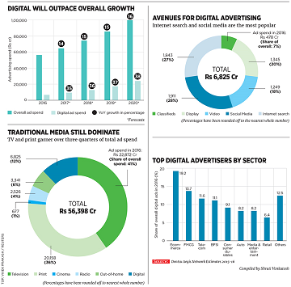
Digital fast moving ahead to take over TV in India : Digital growing faster and stands to take over by 2021

Slide 9
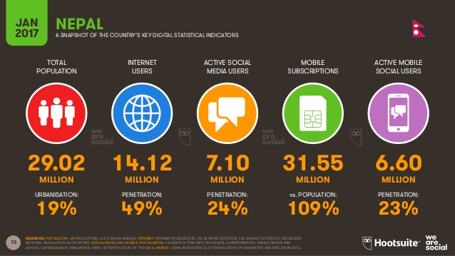
Nepal : Digital media penetrating faster and will take over traditional media in 3-4 years

Slide 10
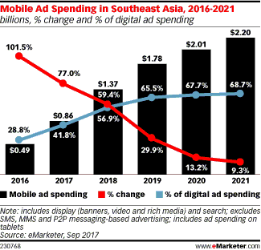
South Asia : Digital growing faster and stands to take over by 2021

Slide 11
Factors affecting Trends :
Smartphones : Arriving only 10 yrs ago, they have completely changed lifestyles. They are
getting further faster, cheaper and better with ever-new features.
Availability of Increasingly cheaper and faster internet
Whopping 8 billion views on youtube, daily
Personalisation has reached a new height as far advertisements are concerned
Twitter moving from 140 to 280 characters
Google Home & Alexa entering our lives like never before
One can be LIVE on Social Media from anywhere
Billions of daily visitors on Facebook which is proving to be their best friend

Slide 12
Trends clearly indicate :
Experiential Marketing : Focusing on the customer experience is at the top of the priority list for most companies.
Personalisation plays a key role as top organisations strive to make experiences as compelling as possible with the integration of artificial intelligence and cloud-based technology.
Content is becoming increasingly important
Customer seeks justification : Customer seeks justification for what is claimed
Brand is the Hero : Brand persona, brand identity, Brand Positioning is becoming
increasinlgy important Digital is growing faster to take over
Marketing Communication rules the business – as it is crucial to get the customers ( and revenue )

Slide 13
Result is, a life full of :

Slide 14
Trend is clear
Digital is growing faster to take over
It is better to start preparing before it takes over

Slide 15
Trends in Digital Advertisements
Interactive Content – QR codes, leading customers to webpage, many other details
engagement with the brands like alerts,
direct communication, QA sessions, , Chatting etc.
Chatbots – Popping up all across your screen
Voice Search – Google leads and a host of others coming in the space
Educating Consumers- Taking then on virtual tours to Products, factories, etc.
Influencer Marketing – Doctors, Architects, Existing satisfied users ( testimonials ), etc.
Co-Branding : This is one of the most interesting things to happen in future
Honesty – Brands making promises to prove their honesty. Honesty attracts customers most.

Slide 16
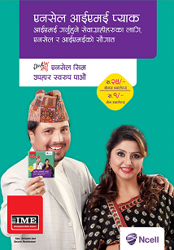
Co-Branding QR Code

Slide 17
The Road Ahead
Invest in future. Invest in Digital Marketing. Get resources – People, Machines, Technology
Invest in well-designed user-journeys that facilitate clear communication
Value creativity and design to differentiate your client’s brands
Combining digital skills with technology to improve customer experience
And Yes,
Print and Outdoors remain valid for future also, as well as TV. Don’t immediately write them off.

Slide 18
Let us be the change-leaders

Slide 19
Reach me at :
deepak@deepakranjan.com
contactdeepakranjan@gmail.com
Read my blogs and my ideas :
www.deepakranjan.com
+91-9432262606 / +91-7603047316
Jai Ho !

